Slide 1
T01_Group # 10
Team Leader: Joseph Koh
Member 2: Arcega Ellexys Lyxanne San Agustin
Member 3: Tun Lin Aung
Member 4: Vincent

Slide 2
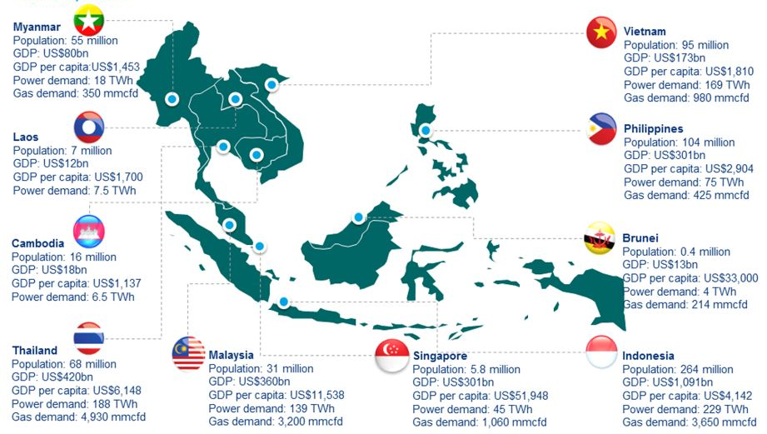
1. Introduction
Example : use Asia regional map showing the Asia region, then put in the host country flag and key info
Key Profile of the host economy :
a) Which part of Asia: South Asia - India
b) GDP growth rate: 7.57%
c) GDP per person: US$2,523.44
d) Unemployment rate: 4.22%
e) Trade Openness: 46.27% of GDP
Note:
Use either computed average over studied period OR the latest year
Which part of Asia
GDP growth rate
GDP per person
Unemployment rate
Trade Openness

Slide 3
1.1 key evidence of industrialisation
Key chart 1
Structural Shift (Stacked Column Chart): Visual evidence of industrialization over time (e.g., a 100% stacked column chart tracking the changing employment shares across Agriculture, Industry, and Services).
Highlight the period of the structural shift

Slide 4
1.2 Effects of Industrialisation
2 chart(s) on effects of industrialisation
Scatterplot of labour productivity with growth of manufacturing sector
Scatterplot Growth of capital per worker with growth of manufacturing sector
A reminder to discuss the trendline wrt the relationship and prediction
or a regression on
Growth of manufacturing sector ( y) with x variables of : labour productivity, GDP per capita, capita per worker
A reminder the units of measurement must be consistent for all the data series

Slide 5
2. FDI growth and effects
Key Chart 2 : Growth & Capital (Line Chart): Long-term trends showing Real GDP growth rates and FDI inflows over time to track macroeconomic cycles.
Carefully examine if key periods of global/regional events of financial crisis have affected the FDI inflow.
A reminder to present and discuss the trendline(s)

Slide 6
2. FDI growth and effects
Key Chart 3: Labor Productivity Link (Scatter Plot): Plot a scatter plot mapping FDI Net Inflows (% of GDP) on the X-axis against Labor Productivity (GDP per person employed) on the Y-axis.
A reminder to present and discuss the trendline

Slide 7
3. Sources of FDI Inflow
Key Chart 4: Source Country Mix (Stacked Bar Chart): Plot a stacked bar chart over time identifying the top 3 nations bringing FDI into your host country.
** you may need to obtain key data from the national statistical site of the host country

Slide 8
3. Sources of FDI Inflow
Key Chart 5 : Bilateral Focus: Identify the single largest source country from your chart.
Plot using line chart to analyze the long-term trendlines of both trade volumes (export and import) and net FDI inflows from this partner.
[You may need to use the combo chart – secondary axis to present the data clearly]
Discuss the trendlines and project their future level of economic cooperation—will their interdependence strengthen, or are they hitting a structural ceiling?

Slide 9
4. Drivers of FDI
Present the regression summary table and interpret the key results
Note if your regression R2 is low (<0.5) or all p values of x variables significantly high, you need to re-run the regression with necessary time period and/or data adjustment

Slide 10
5. THE CHINA DYNAMIC (COLLABORATION VS. COMPETITION)
Key Chart 6: Trade & Pacts (Line Chart): Plot the growth rate of bilateral trade with China.
In your chart, note relevant periods where key structural breaks when regional trade agreements (e.g., RCEP, ASEAN-China FTA) were implemented.
RCEP
ASEAN China FTA
Sample
US-SG FTA

Slide 11
6. Long term relationship with China
Discussion here is open ended.
Suggestion 1: Compute the GVC backward participation rate
( = foreign value added from china / total export of host country ) and interpret the values
Suggestion 2: Run a regression on
Y ( FDI flows from China)
X variables : volume of bilateral trade, number of new trade pacts, + 1 or 2 other variables

